Slide 1
18-545 Project Proposal
TeAM M-X BUTTERFLY
Ashish Shrestha, hui jun tay, peter pearson

Slide 2
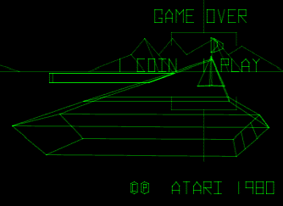
Project Proposal
Re-create 1980 Atari Battlezone

Slide 3
Project Breakdown
6502 Processor
Memory
Graphics
Sound
User interface

Slide 4
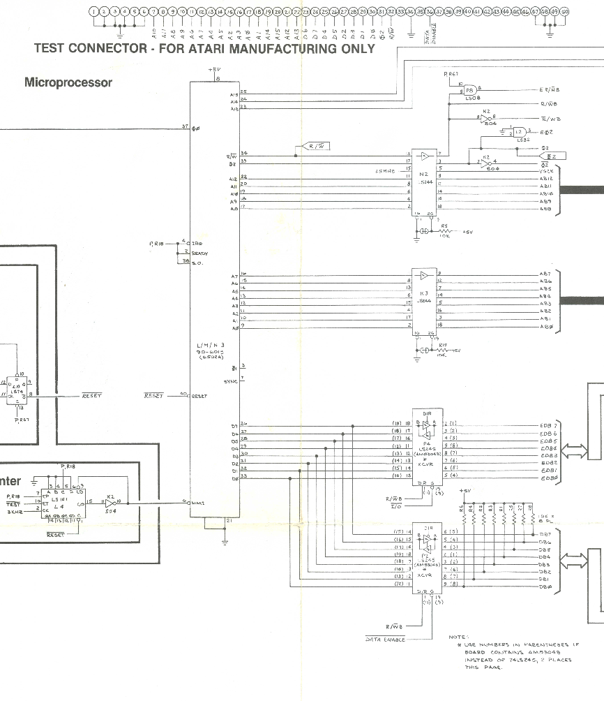
6502 Processor
8-bit microprocessor unit
Popular for arcade machines
Been used before – Atari, NES
Open source cores online
Testbenches are available
Full ISA and datasheet available

Slide 5
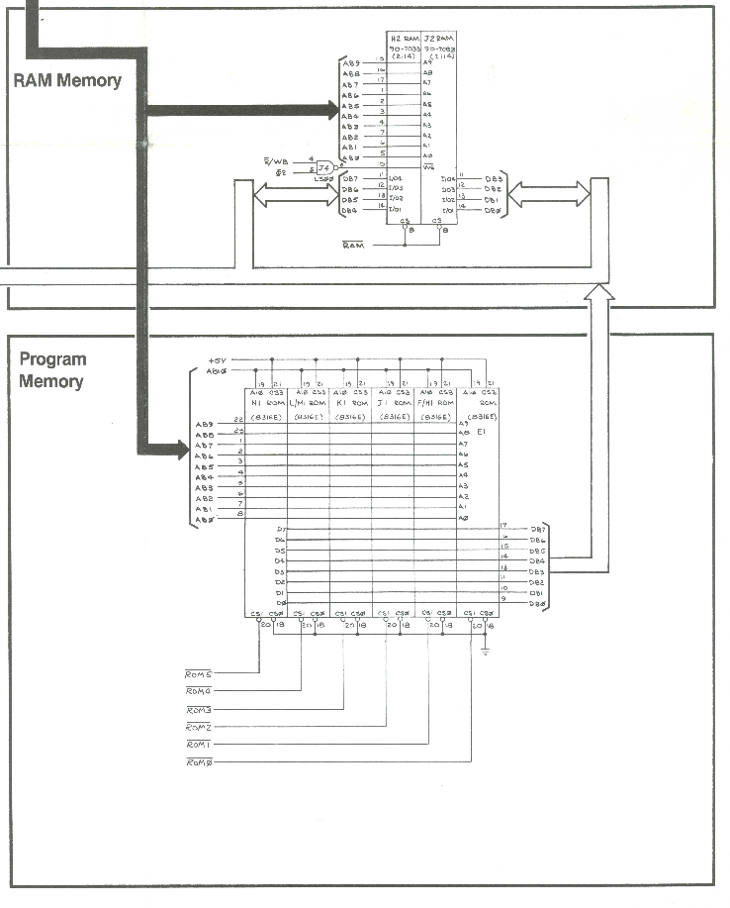
Memory
Original ROM is online
MAME simulation is available
Can debug game through assembly
Get memory dump
Memory mapping documentation is available

Slide 6
Graphics
Battlezone uses Vector Graphics
Atari Analog Vector Generator
Draws lines on screen using electron gun
Full schematics available online (including ISA)
VGA Conversion
Planning to convert vector graphics into a VGA screen
Initial design uses frame buffer (~307k monochrome pixels)
First in this class (some work online)

Slide 7
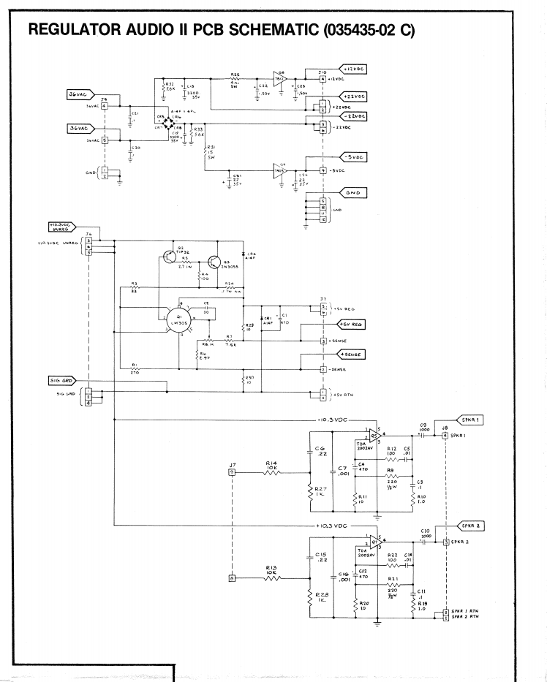
Sound
POKEY plus discrete circuits
Schematic is available
Haven’t decided:
Emulate sound system
Re-build circuitry from schematic

Slide 8
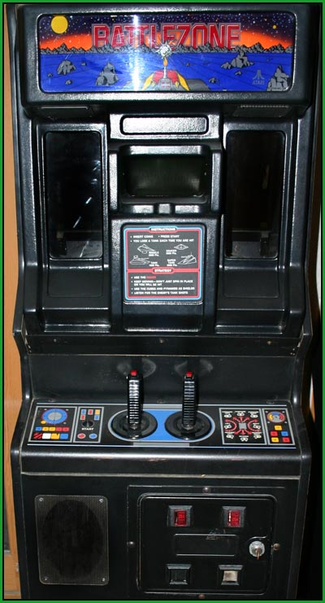
User Interface
Closely replicate arcade machine input
Joysticks with buttons on top

Slide 9
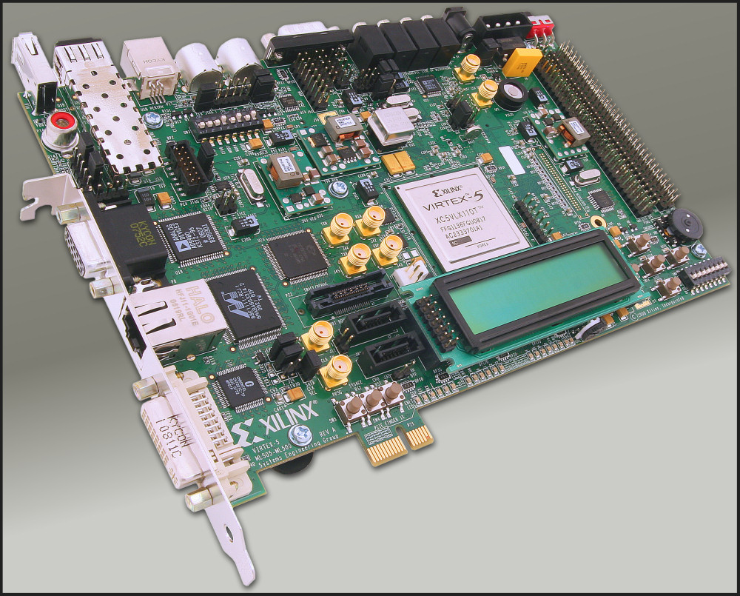
FPGA
Virtex 5
Other game teams have used it before
Don’t need too much power
VGA output

Slide 10
Resources
Andy’s Arcade (for schematics and ROMs)
FPGAarcade forums (discussion and info on the Analog Vector Generator)
MAME site and forums (debugger, ROMs for simulation and memory dump)
NESHQ (assembler, simulator and other resources for 6502)
Opencores (for 6502 design)
Core debugger from past semester’s Atari project
Past semesters have significant reference material (Atari 5200 team, 1942 and DK teams)

